Slide 1
Foundations of Modern Software Systems
Module-3: Compute
Instructor: Piyush Goel
N.M.A.M. Institute of Technology

Slide 2
Structure of the Course
Module-3: Compute
Process, Threads, Memory.
Servers, Virtual Machines, and Containers.
Application Servers (Web Servers, FTP, Email)
Cloud Computing Basics.
Module-4: Networking
Building Blocks (OSI Layer Models, Network Topologies, Subnets, VPNs, etc.)
Naming Systems (DNS)
Important Protocols
TCP/UDP
HTTP
Web Sockets
Network Security (SSL/TLS)
Other Security Models (Zero-Trust, etc.)
Module-1: Introduction
Module-2: Storage
Basics (Data Types)
Data Storage Fundamentals
Structuring & Querying
Databases
Types
Data Schemas
Object Storage
* We will have a few guest lectures from the other industry experts.

Slide 3
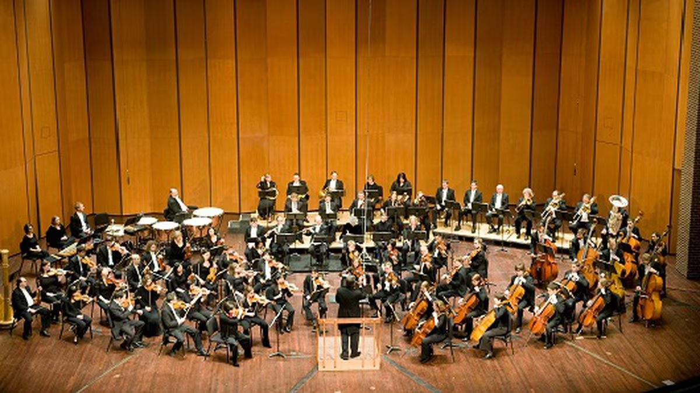
What are the components of the software stack in a Food Delivery Business?
Restaurant Listing
Order Management System
User Management
Ratings & Reviews
Abuse Prevention
Image Management (CDN)
Payments Processing
Order Tracking System
Restaurant Management
Delivery Tracking
Delivery Partners Management
Accounting for the Delivery Partners.
Accounting for the Restaurants
Table Booking System
Communications (SMS/Push Notifications)
And many more…..
It’s a Symphony of Software Modules!

Slide 4
What are the building blocks of these massive, and sophisticated pieces of software?

Slide 5
Building Blocks

Slide 6
Building Blocks (Abstract)
Storage
Compute
Networking & Security

Slide 7
Building Blocks (Abstract)
Storage
Compute
Networking & Security
Data Structures and Algorithms

Slide 8
Building Blocks - Compute
Storage
Compute
Networking & Security

Slide 9
Module-3: Compute

Slide 10

Building Blocks - Compute
Represents the “Execution” portion of any software.
Instruction Execution on the Processor.
Different Models of Execution
Process Driven
Thread Driven
Security Parameters
System Level
User Level
Scheduling
Interesting Class of Problems
Packaging
Vanilla Executables
Containers
Virtual Machines
Compute Capacity
Processor Architecture
Clock Frequency
Memory

Slide 11
How is the Execution Orchestrated?

Slide 12
We require a Master Co-ordinator to control the execution.

Slide 13
We require a Master Co-ordinator to control the execution.
This coordinator is the Operating System.

Slide 14
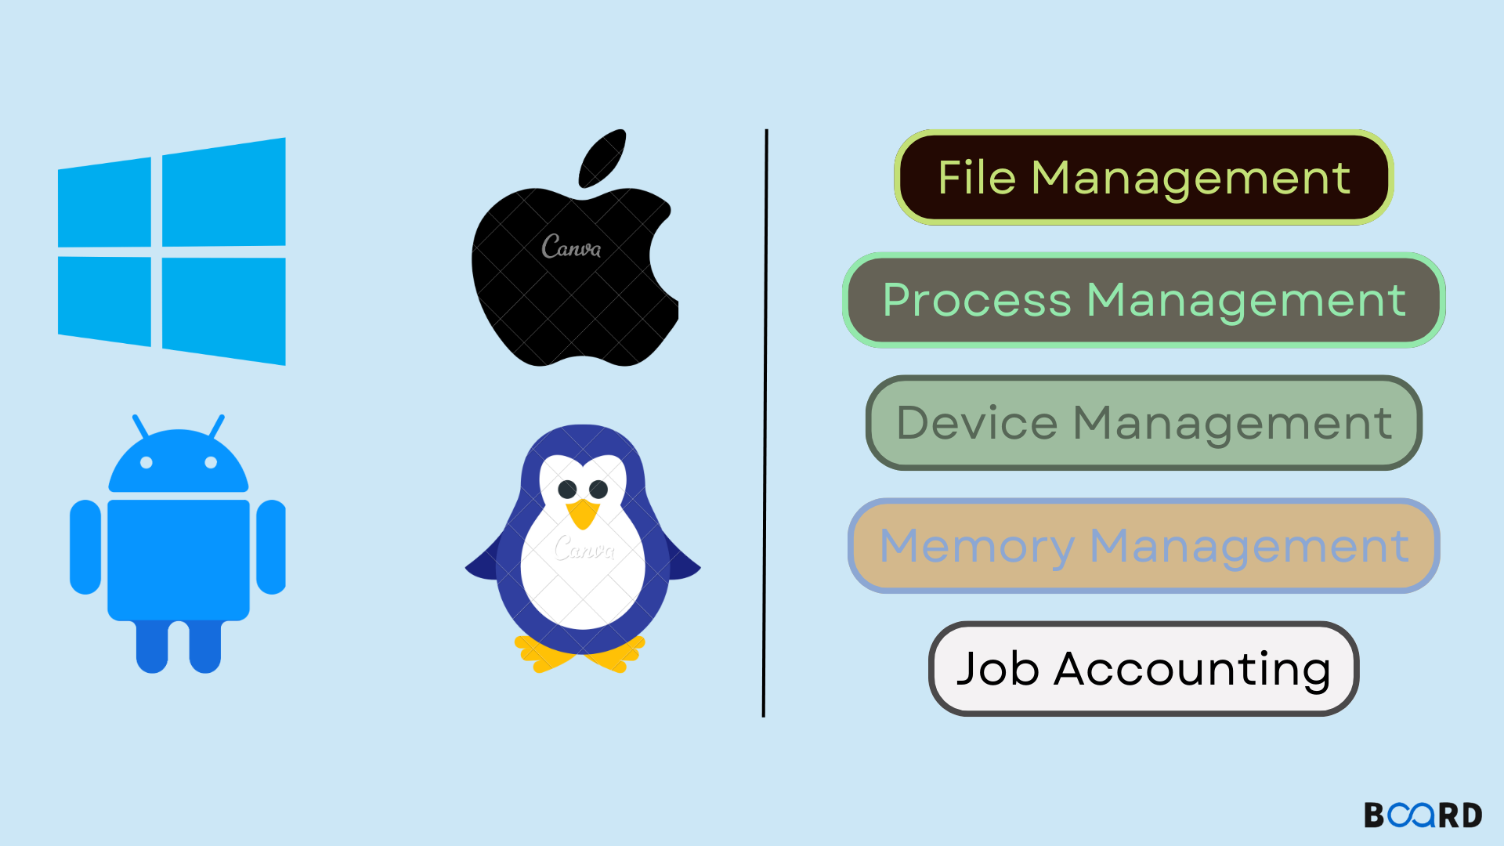
An operating system (OS) is the program that, after being initially loaded into the computer by a boot program, manages all of the other application programs in a computer. The application programs make use of the operating system by making requests for services through a defined application program interface (API).

Slide 15
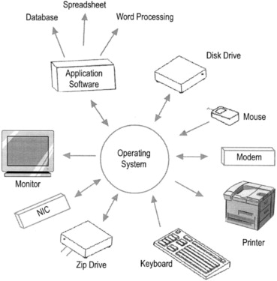
An operating system (OS) is the program that, after being initially loaded into the computer by a boot program, manages all of the other application programs in a computer. The application programs make use of the operating system by making requests for services through a defined application program interface (API).

Slide 16
How do the programs interact with the Operating System?

Slide 17
System Calls
In computing, a system call (commonly abbreviated to syscall) is the programmatic way in which a computer program requests a service from the operating system^{[a]} on which it is executed. This may include hardware-related services (for example, accessing a hard disk drive or accessing the device's camera), creation and execution of new processes, and communication with integral kernel services such as process scheduling. System calls provide an essential interface between a process and the operating system.
* https://en.wikipedia.org/wiki/System_call
Process Management
File Management
Memory Management
Network Interaction
Communication
System Information
Security!

Slide 18
What is the fundamental unit of execution on an Operating System?

Slide 19
The fundamental unit of execution is a “Program in Execution”, aka, “Process.”

Slide 20
Let’s understand using a live example.

Slide 21
Process (Theory)

Slide 22
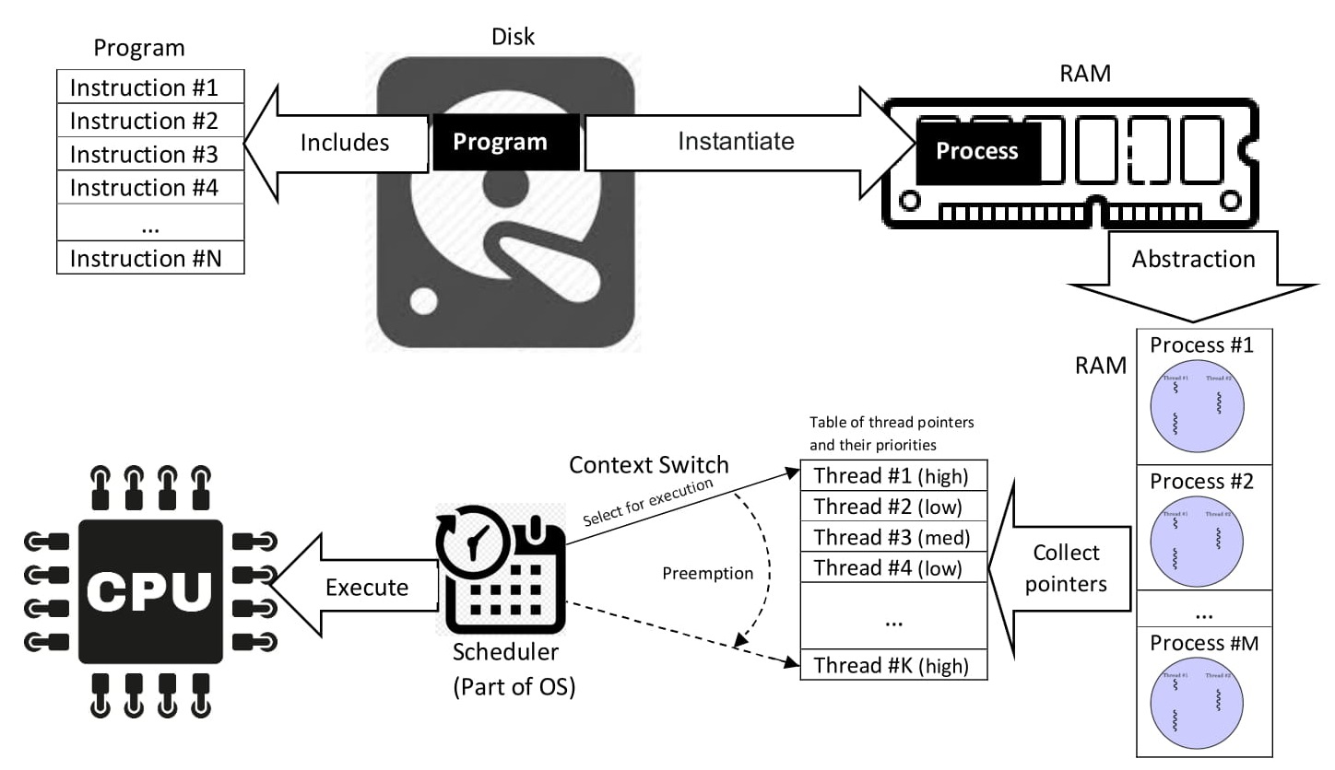
What is a Process?
In computing, a process is the instance of a computer program that is being executed by one or many threads. There are many different process models, some of which are light weight, but almost all processes (even entire virtual machines) are rooted in an operating system (OS) process which comprises the program code, assigned system resources, physical and logical access permissions, and data structures to initiate, control and coordinate execution activity. Depending on the OS, a process may be made up of multiple threads of execution that execute instructions concurrently.^{[1][2]}
* https://en.wikipedia.org/wiki/Process_(computing)

Slide 23
What is a Process? (..contd)
While a computer program is a passive collection of instructions typically stored in a file on disk, a process is the execution of those instructions after being loaded from the disk into memory. Several processes may be associated with the same program; for example, opening up several instances of the same program often results in more than one process being executed.
* https://en.wikipedia.org/wiki/Process_(computing)

Slide 24
What is a Process? (..contd)
Program is passive entity stored on disk (executable file), process is active
Program becomes process when executable file loaded into memory
Execution of program started via GUI mouse clicks, command line entry of its name, etc
Process execution must progress in sequential fashion.
* https://www.os-book.com/OS9/slide-dir/PPT-dir/ch3.ppt

Slide 25
What is a Process?
The program code, also called text section
* Stack containing temporary data
Function parameters, return addresses, local variables
Data section containing global variables
Heap containing memory dynamically allocated during run time
Current activity including program counter, processor registers
Program Code
Assigned System Resources
Physical and Logical Access permissions.
Data structures to initiate
Control and coordinate execution activity.
* Stack word is partially overloaded here.

Slide 26
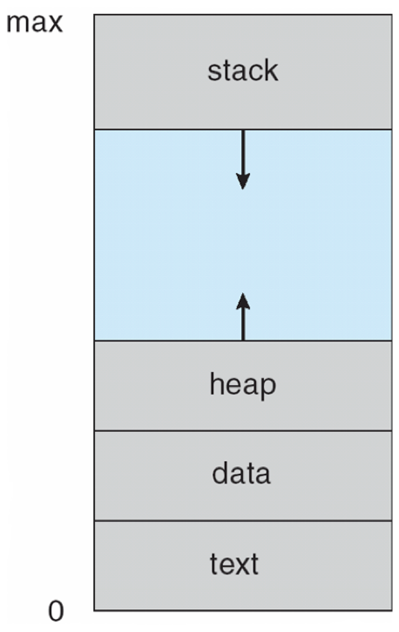
What is a Process?
The program code, also called text section
Stack containing temporary data
Function parameters, return addresses, local variables
Data section containing global variables
* Heap containing memory ** dynamically allocated during run time
Current activity including *** program counter, processor registers.
* Heap is an overloaded term.
** What is Dynamic Allocation of Memory?
*** Program Counter is an logical concept for
tracking the execution sequence.

Slide 27
We will be cooking Maggi and Brewing Coffee in this Module! =)

Slide 28


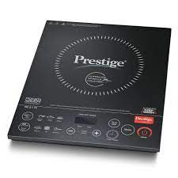

We will be cooking Maggi and Brewing coffee in this Module! =)
* Common Components: Induction Stove, Pan, Spoon, Water
* They will form Global and Shared Variables in our programs as we move along.

Slide 29
Imagine a scenario where you and your sibling want to cook Maggi, and brew Coffee respectively.
You have the ingredients needed, and other kitchen equipments are shared (Induction Stove, Pan, Spoon, Water Jar)
You cannot communicate to your sibling directly. You cannot exchange messages with each other. **
Your mum is present in the kitchen and your communication is limited to her.
She will direct and guide you on the usage of the shared equipments.
The shared equipments are kept at a specific location on the shelf controlled by your mum.
The food specific ingredients are kept in shelves managed by you.
* What could be the reason for this?

Slide 30
Sample Programs for Cooking Maggi & Brewing Coffee.
Take packet(s) of Maggi, and a bowl.
Gather a Washed Pan, Spoon, Induction Stove, Water.
Add Water to the Pan.
Heat the water for 30 seconds.
Add the Maggi Masala and stir it with the spoon.
Let the water and masala boil for 20 seconds.
Break the Maggi cake into two.
Add to the pan.
Stir the Maggi every few seconds.
Keep heating until the water has evaporated and the noodles have softened up.
Turn off the induction Stove.
Pour the Maggi into a bowl, and eat.
Take the coffee beans, the Percolator Pot, a coffee mug, and creamer.
Gather the Spoon, Induction Stove, the Water.
Add the beans with a Spoon to the Percolator Pot.
Add Water to the Pot.
Close the Pot and put it on the Induction Stove.
Heat the Percolator Pot for 5 mins until it starts steaming.
Steam for 2 more mins.
Turn off the Induction Stove.
Pour the coffee from the Percolator Pot into the Coffee Mug.
Add Creamer, and drink the coffee.
* These instructions are nowhere close to a machine understandable procedure.

Slide 31
Program Code: the executable binary format of the program.
Take packet(s) of Maggi, and a bowl.
Gather a Washed Pan, Spoon, Induction Stove, Water.
Add Water to the Pan.
Heat the water for 30 seconds.
Add the Maggi Masala and stir it with the spoon.
Let the water and masala boil for 20 seconds.
Break the Maggi cake into two.
Add to the pan.
Stir the Maggi every few seconds.
Keep heating until the water has evaporated and the noodles have softened up.
Turn off the induction Stove.
Pour the Maggi into a bowl, and eat.
Assigned System Resources: the Induction Stove, Pan, Water Jar, Spoon.
Data Structures to initiate: Gathering the shared resources, and collecting the ingredients is basic ground work.
Physical and Logical Access Permissions:
Physical Permissions: Access to the Shelf.
Logical Permissions: If your sibling is under 15 years, she may not be allowed to access the stove.
Control and Coordination Activities:
Since you and your sibling can’t communicate, your mum is controlling the access, and coordinating the use of the shared resources.

Slide 32
How do so many processes execute on a limited number of processors?

Slide 33
Concurrency vs Parallelism

Slide 34
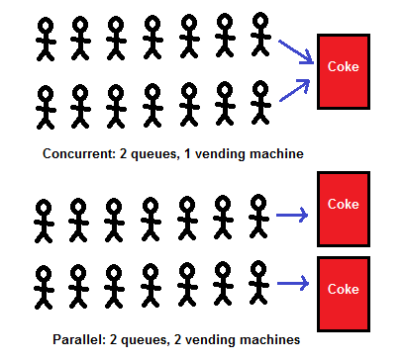
Concurrency vs Parallelism

Slide 35
Concurrency vs Parallelism
Concurrency is about dealing with lots of things at once. Parallelism is about doing lots of things at once. An application can be concurrent — but not parallel, which means that it processes more than one task at the same time, but no two tasks are executing at the same time instant.
* https://medium.com/@itIsMadhavan/concurrency-vs-parallelism-a-brief-review-b337c8dac350

Slide 36
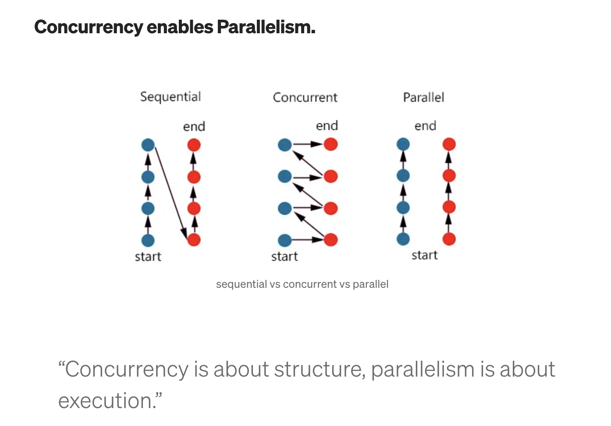
Concurrency vs Parallelism
* https://kwahome.medium.com/concurrency-is-not-parallelism-a5451d1cde8d

Slide 37
Module-3: Lecture-2

Slide 38
Module-3: Lecture-1 Recap

Slide 39
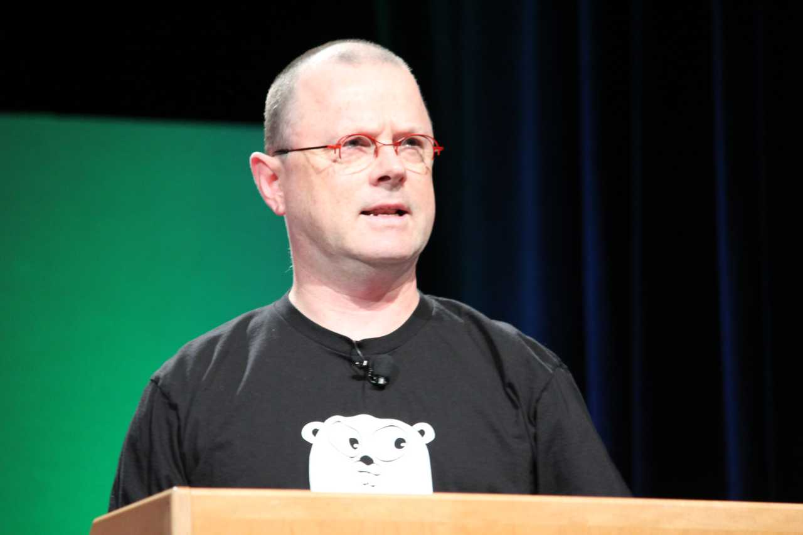
Concurrency vs Parallelism
Rob Pike
Co-Creator of Unix, UTF-8, Go,
* https://www.youtube.com/watch?v=oV9rvDllKEg&t=2s&ab_channel=gnbitcom

Slide 40
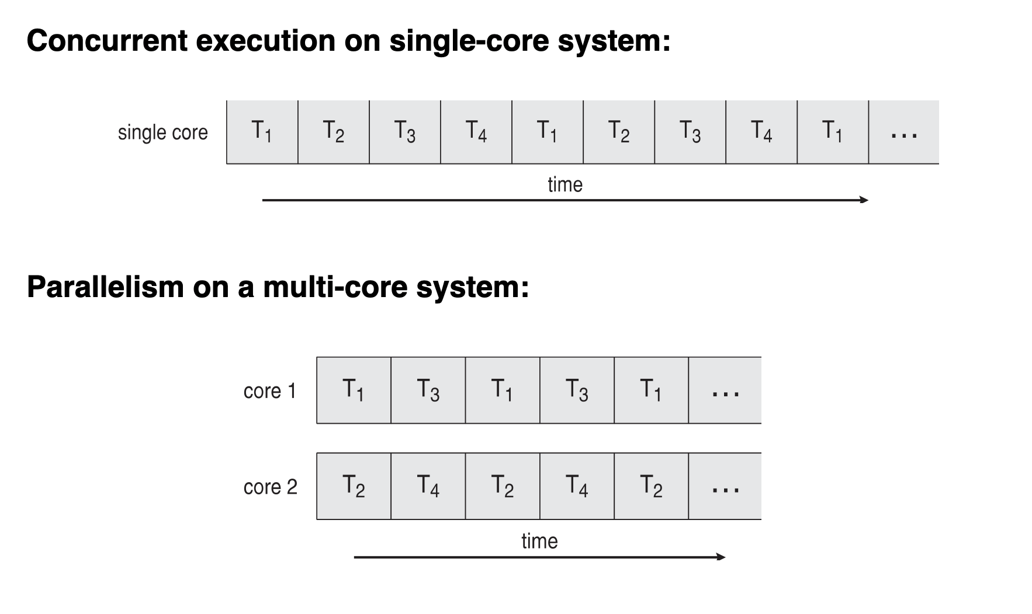
Concurrency vs Parallelism

Slide 41
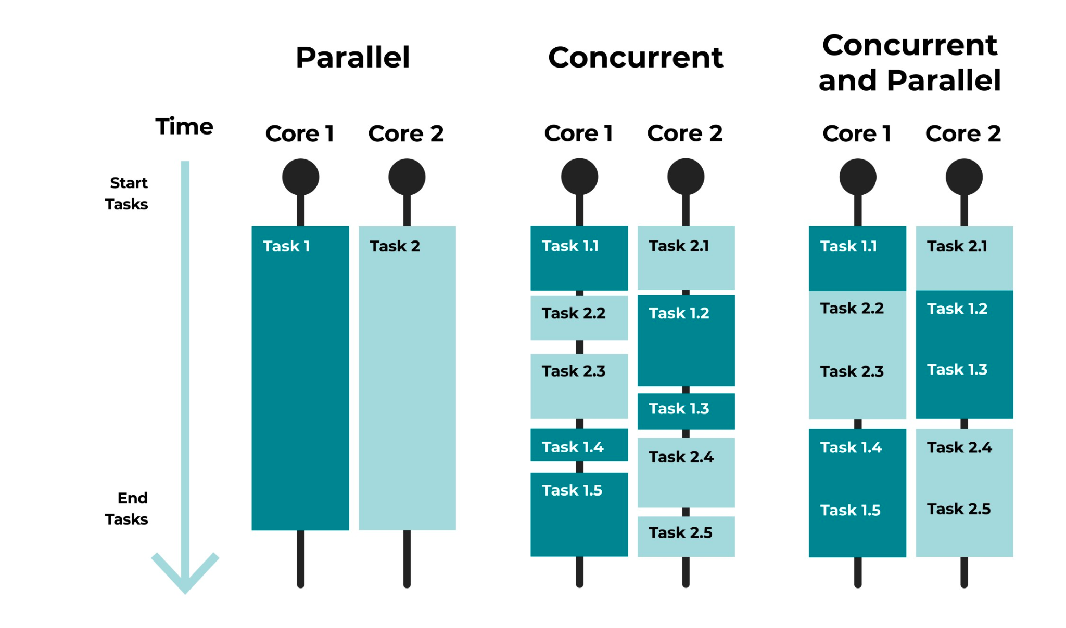
Concurrency vs Parallelism

Slide 42
Process Contd…

Slide 43
Process States

Slide 44
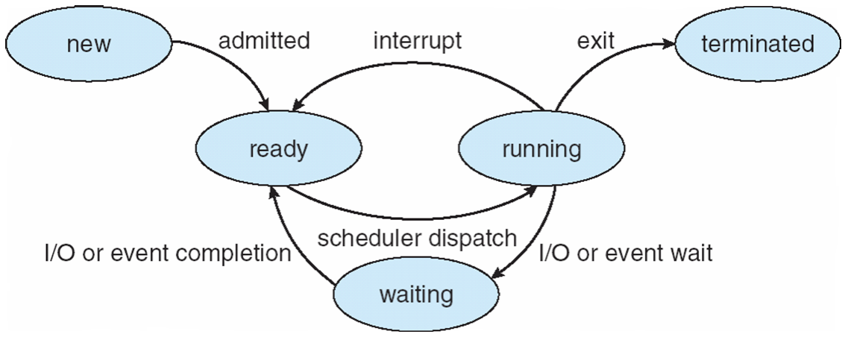
States of a Process
new: The process is being created
running: Instructions are being executed
waiting: The process is waiting for some event to occur
ready: The process is waiting to be assigned to a processor
terminated: The process has finished execution

Slide 45
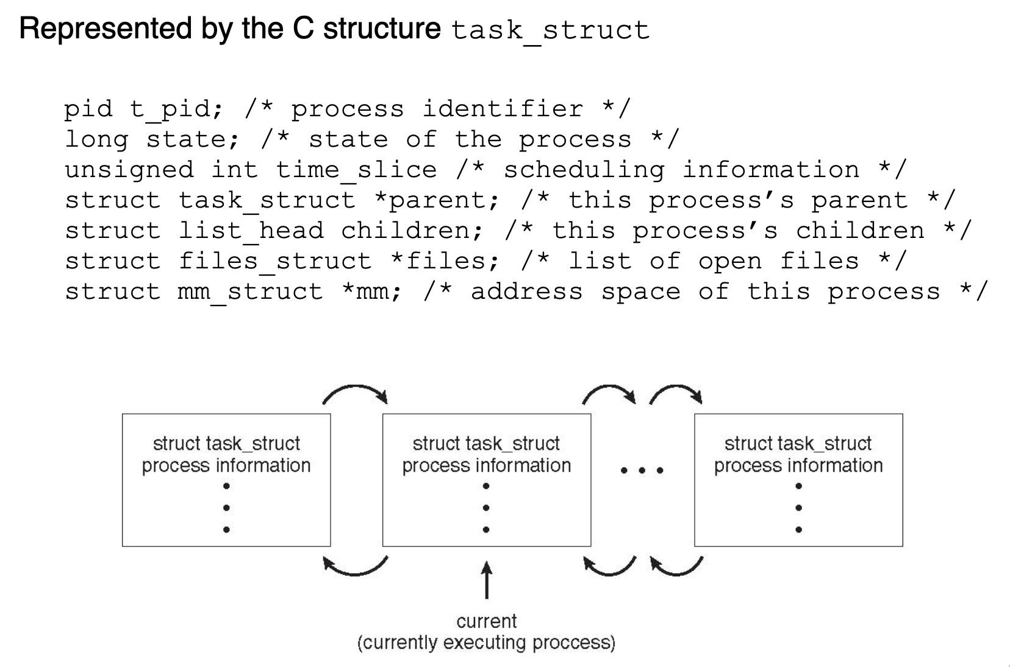
Process Representation as a C structure

Slide 46
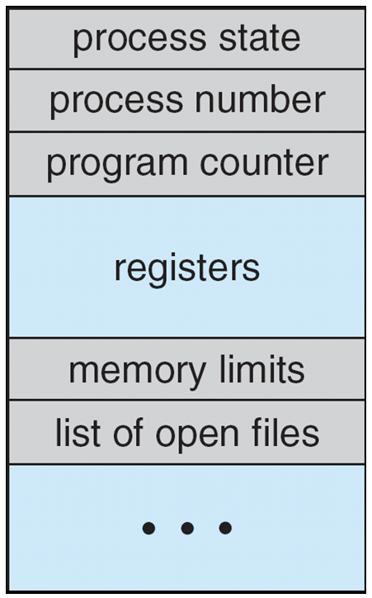
Process Structure
Information associated with each process
(also called task control block or Process Control Block (PCB)
Process state – running, waiting, etc
Program counter – location of instruction to next execute
CPU registers – contents of all process-centric registers
CPU scheduling information- priorities, scheduling queue pointers
Memory-management information – memory allocated to the process
Accounting information – CPU used, clock time elapsed since start, time limits
I/O status information – I/O devices allocated to process, list of open files
* https://github.com/torvalds/linux/blob/master/include/linux/sched.h#L743
* https://tldp.org/LDP/tlk/ds/ds.html

Slide 47
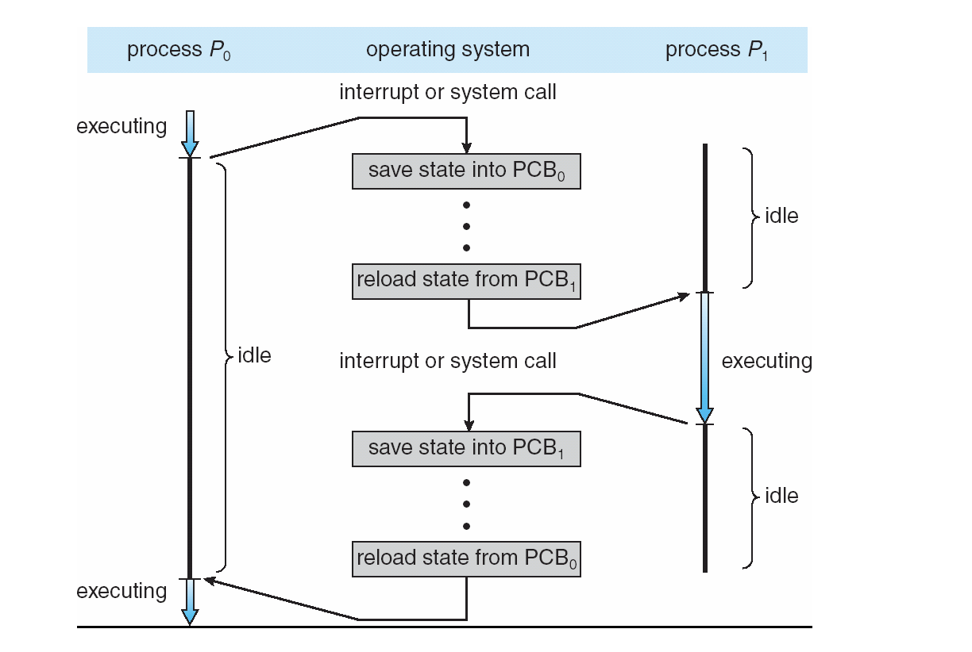
Process Switching Flow
* https://www.os-book.com/OS9/slide-dir/PPT-dir/ch3.ppt

Slide 48
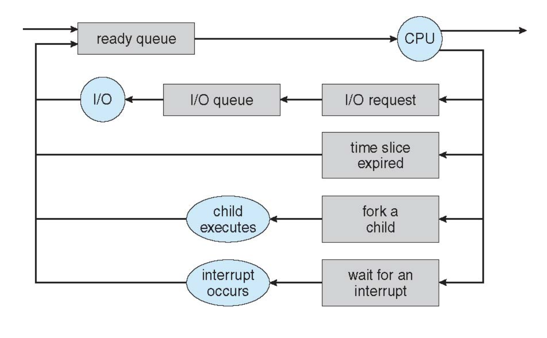
Scheduling
Maximize CPU use, quickly switch processes onto CPU for time sharing
Process scheduler selects among available processes for next execution on CPU
Maintains scheduling queues of processes
Job queue – set of all processes in the system
Ready queue – set of all processes residing in main memory, ready and waiting to execute
Device queues – set of processes waiting for an I/O device
Processes migrate among the various queues
* https://www.os-book.com/OS9/slide-dir/PPT-dir/ch3.ppt

Slide 49
Schedulers
Short-term scheduler (or CPU scheduler) – selects which process should be executed next and allocates CPU
Sometimes the only scheduler in a system
Short-term scheduler is invoked frequently (milliseconds) ⇒ (must be fast)
Long-term scheduler (or job scheduler) – selects which processes should be brought into the ready queue
Long-term scheduler is invoked infrequently (seconds, minutes) ⇒ (may be slow)
The long-term scheduler controls the degree of multiprogramming
Processes can be described as either:
I/O-bound process – spends more time doing I/O than computations, many short CPU bursts
CPU-bound process – spends more time doing computations; few very long CPU bursts
Long-term scheduler strives for good process mix – Why?
* https://www.os-book.com/OS9/slide-dir/PPT-dir/ch3.ppt

Slide 50
Load Average and CPU Performance

Slide 51
Process States and Performance (Load Average)
Load average is a metric that shows the average number of threads running or waiting at a particular time. It helps Linux users understand how system resources are engaged.
What is load average?
What it measures: The average number of processes that are either in the run queue or waiting for a turn to run on the CPU.
How it's calculated: The sum of the waiting and the running threads.
How it's displayed: The system load averages over a time of fifteen, five, and one minute.
It’s not same as CPU Utilisation!

Slide 52
Question: The OS is managing 100s/1000s of processes (and threads), and has to schedule them in nearly microseconds; What kind of data structures are used by the scheduler?

Slide 53
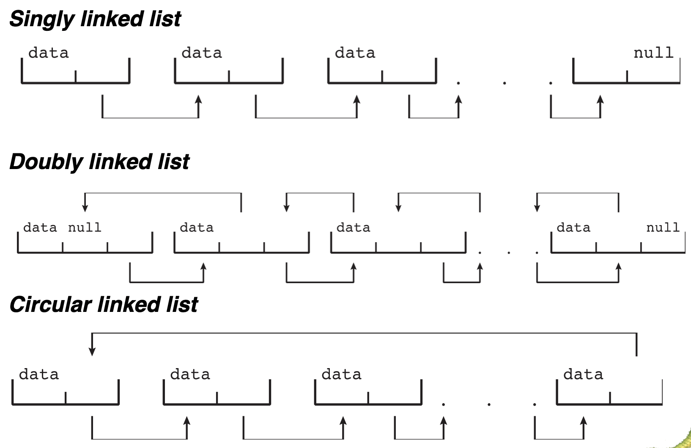
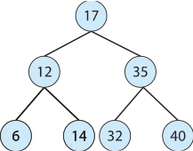
Kernel Data Structures
Similar to standard programming data structures
Binary search trees (Variants)
* Lists - https://github.com/torvalds/linux/blob/master/include/linux/list.h
* Red Black Tree - https://github.com/torvalds/linux/blob/master/include/linux/rbtree.h
* Hashmap - https://github.com/torvalds/linux/blob/master/tools/lib/bpf/hashmap.c

Slide 54
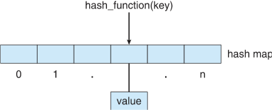
Kernel Data Structures
Similar to standard programming data structures
Hash Functions → Hash Maps
Bitmap – string of n binary digits representing the status of n items
* Lists - https://github.com/torvalds/linux/blob/master/include/linux/list.h
* Red Black Tree - https://github.com/torvalds/linux/blob/master/include/linux/rbtree.h
* Hashmap - https://github.com/torvalds/linux/blob/master/tools/lib/bpf/hashmap.c

Slide 55
Kernel Data Structures - Use Cases
Managing Process Queues (States)
File Management - Directory Tree
Memory Management (Memory blocks)
I/O process queues.
Configurations
Timers for Processors (Sleep function)
Memory Buffers
Cache Management

Slide 56
Red-Black Trees
Linux Scheduler uses the Red-Black Trees for process selection.
Guarantee good “Worst Case” Performance.
Search: O(log n)
Insert: O(log n)
Delete: O(log n)
Space: O(log n)
Can easily reside in kernel memory → increasing the overall efficiency.
*https://www.quora.com/Why-does-the-Linux-Completely-Fair-Scheduler-use-a-red-black-tree-instead-of-the-simpler-array-with-queues
* https://developer.ibm.com/tutorials/l-completely-fair-scheduler/
* https://stackoverflow.com/questions/33191110/reason-why-cfs-scheduler-using-red-black-tree

Slide 57
Process Contd…

Slide 58
Process Switching Flow
* https://www.os-book.com/OS9/slide-dir/PPT-dir/ch3.ppt

Slide 59
Context Switch
When CPU switches to another process, the system must save the state of the old process and load the saved state for the new process via a context switch.
Context of a process represented in the PCB.
Context-switch time is overhead; the system does no useful work while switching.
The more complex the OS and the PCB ➔ the longer the context switch.
Time dependent on hardware support.
Some hardware provides multiple sets of registers per CPU ➔ multiple contexts loaded at once.
Excessive Context Switch is not good for a system!
* https://www.os-book.com/OS9/slide-dir/PPT-dir/ch3.ppt

Slide 60
Module-3:Compute, Lecture-3

Slide 61
Process Controls

Slide 62
Process Controls
Creation
Termination
Priority Management
Signals/Interrupts

Slide 63
Process Controls - Creation
Parent process create children processes, which, in turn create other processes, forming a tree of processes
Generally, process identified and managed via a process identifier (pid)
Resource sharing options
Parent and children share all resources
Children share subset of parent’s resources
Parent and child share no resources
Execution options
Parent and children execute concurrently
Parent waits until children terminate

Slide 64
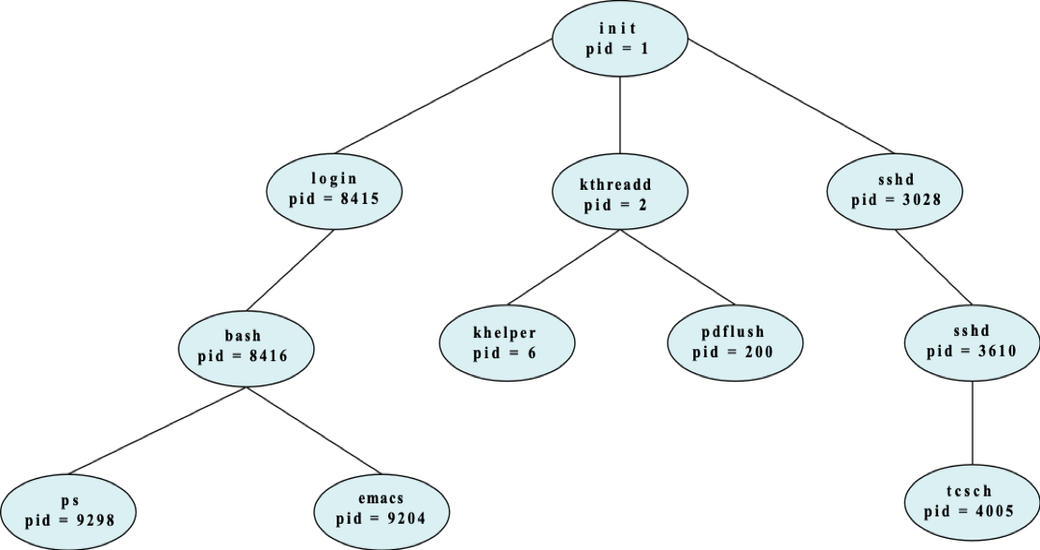
Process Controls - Process Tree
pstree Command

Slide 65
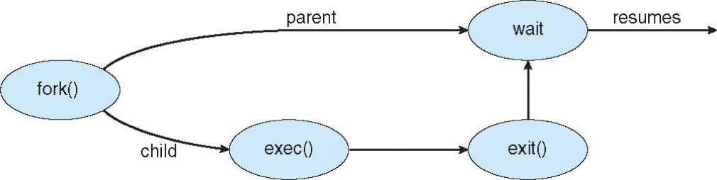
Process Controls - Creation
Address space
Child duplicate of parent
Child has a program loaded into it
UNIX examples
fork() system call creates new process
exec() system call used after a fork() to replace the process’ memory space with a new program

Slide 66
Process Controls - Termination
Process executes last statement and then asks the operating system to delete it using the exit() system call.
Returns status data from child to parent (via wait())
Process’ resources are deallocated by operating system
Parent may terminate the execution of children processes using the abort() system call. Some reasons for doing so:
Child has exceeded allocated resources
Task assigned to child is no longer required
The parent is exiting and the operating systems does not allow a child to continue if its parent terminates

Slide 67
Process Controls - Termination
Some operating systems do not allow child to exists if its parent has terminated. If a process terminates, then all its children must also be terminated.
cascading termination. All children, grandchildren, etc. are terminated.
The termination is initiated by the operating system.
The parent process may wait for termination of a child process by using the wait()system call. The call returns status information and the pid of the terminated process
pid = wait(&status);
If no parent waiting (did not invoke wait()) process is a zombie
If parent terminated without invoking wait , process is an orphan

Slide 68
Process Controls - Priority Management
Since the Scheduler manages the CPU allocation, the executing program has not direct way to influence the allocation.
The Kernel gives an option to the program to ask for a priority while scheduling.
System call - Nice
Lower the “Niceness”, higher the aggressiveness in scheduling.
It’s a indicator for scheduling. No guarantee.
The final control is still with the Scheduler.

Slide 69
Process Controls - Signals/Interruptions
Signals are used in UNIX systems to notify a process that a particular event has occurred.
A signal handler is used to process signals
Signal is generated by particular event
Signal is delivered to a process.
Signal is handled by one of two signal handlers:
default
user-defined
Every signal has default handler that kernel runs when handling signal
User-defined signal handler can override default
For single-threaded, signal delivered to process

Slide 70
Process Status Details
ProcFS
Everything is a file in Linux/Unix/BSD.
https://en.wikipedia.org/wiki/Procfs
The proc filesystem (procfs) is a special filesystem in Unix-like operating systems that presents information about processes and other system information in a hierarchical file-like structure, providing a more convenient and standardized method for dynamically accessing process data held in the kernel than traditional tracing methods or direct access to kernel memory. Typically, it is mapped to a mount point named /proc at boot time. The proc file system acts as an interface to internal data structures about running processes in the kernel. In Linux, it can also be used to obtain information about the kernel and to change certain kernel parameters at runtime (sysctl).
Activity Monitor/Task Managers are picking information from a similar interface.

Slide 71
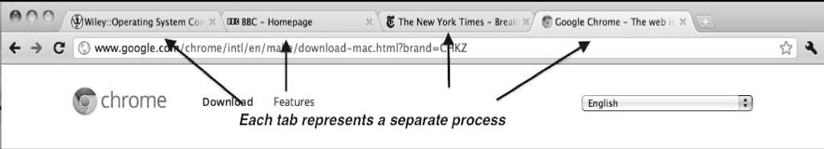
Chrome Browser
Many web browsers ran as single process (some still do)
If one website causes trouble, entire browser can hang or crash
Google Chrome Browser is multiprocess with 3 different types of processes:
Browser process manages user interface, disk and network I/O
Renderer process renders web pages, deals with HTML, Javascript. A new renderer created for each website opened
Runs in sandbox restricting disk and network I/O, minimizing effect of security exploits
Plug-in process for each type of plug-in

Slide 72
Threads

Slide 73
Threads
Processes are selfish - they don’t share stuff!
Consequently, they require a “lot of work” for creation/initiation.
Resource Handling (file handles, sockets, device handles, windows, and a process control block.)
Memory Space management
Et al.
Scheduling becomes bulky
Wastage of the precious CPU cycles.
Can we think of a lighter mechanism of computation or program abstraction?
THREADS!
Designed sometime in the 80’s.
While the concepts were largely known even in the 50s/60s.

Slide 74
Threads
Lightweight unit of scheduling and computation.
What makes them lightweight?
Sharing of resources (the heavy ones). Does not have a “Data Segment/Heap” of its own.
Keeping a copy of program counter, local variables (Stack)
Thread will always be spawned from a Process. Cannot be created on its own.
A process will always have at least one thread of execution.
A Process can create multiple threads as needed. A Process can create other Processes as needed.
A Thread can create other Threads as needed. They will share the same Address space as the parent Thread. A Thread cannot create a new Process.
If a Thread dies, it’s stack is reclaimed (cleaned).
If a Process exits, it’s threads are terminated and stacks reclaimed.
Threads can communicate easily since they share the Memory space!

Slide 75
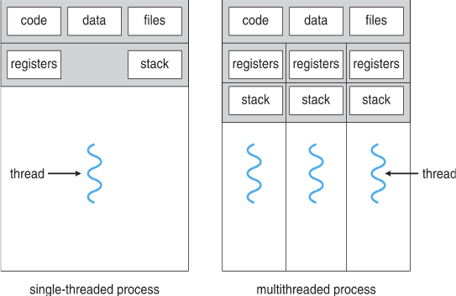
Threads

Slide 76
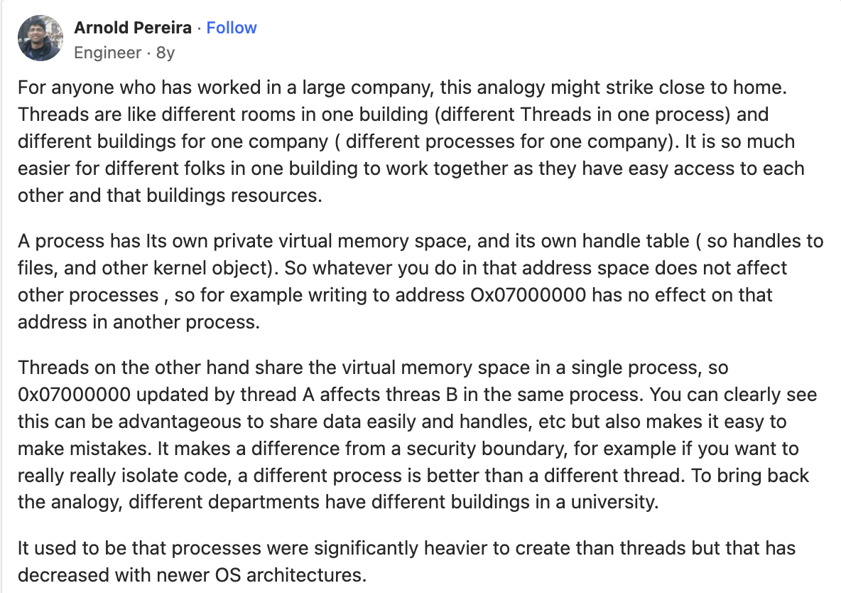
Threads
* https://www.quora.com/What-is-the-difference-between-a-process-and-a-thread

Slide 77
Threads
Kernel Threads
A kernel thread is a kernel entity, like processes and interrupt handlers; it is the entity handled by the system scheduler. The programmer has no direct control over these threads, unless you are writing kernel extensions or device drivers. These threads, known by the system scheduler, are strongly implementation-dependent. To facilitate the writing of portable programs, libraries provide user threads.
User Threads
A user thread is an entity used by programmers to handle multiple flows of controls within a program. The API for handling user threads is provided by the threads library. A user thread only exists within a process; a user thread in process A cannot reference a user thread in process B. The library uses a proprietary interface to handle kernel threads for executing user threads. The user threads API, unlike the kernel threads interface, is part of a POSIX-standards compliant portable-programming model. Thus, a multithreaded program developed on an AIX® system can easily be ported to other systems.

Slide 78
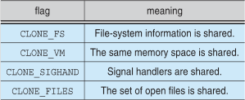
Linux Threads
Linux refers to them as tasks rather than threads
Thread creation is done through clone() system call
clone() allows a child task to share the address space of the parent task (process)
Flags control behavior
struct task_struct points to process data structures (shared or unique)

Slide 79
Live Examples

Slide 80
Thread Creation & Management
POSIX Libraries
Java Threads
Python Threads
Respective class implementations
Thread Pools
Python Threadpool Example

Slide 81
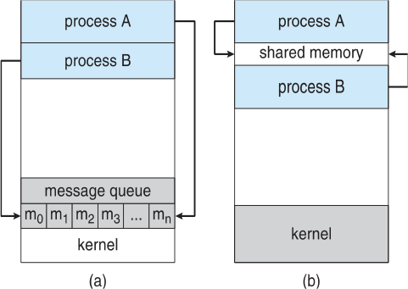
Inter-Process/Thread Communication
Processes of Threads within a system may be independent or cooperating.
Independent
Data Shuffling
Cooperating
For coordinated execution.
Example MergeSort
Process Communication
Shared Memory
Shared segment of memory to which
data is written.
Message Passing
Queues

Slide 82
Inter-Process/Thread Communication
Threads share the processes address space. A lot easier to communicate.
Communication for Synchronisation
Synchronisation Examples
MergeSort
Maggi & Coffee
Friends Meeting for dinner.
Ordering Food at a Food court.
Entering/Exiting the Auditorium.
Turnstiles at a Security Counter.

Slide 83
Communication Models
Blocking && Non-Blocking (Examples)
Blocking is considered synchronous
Blocking send -- the sender is blocked until the message is received
Blocking receive -- the receiver is blocked until a message is available
Non-blocking is considered asynchronous
Non-blocking send -- the sender sends the message and continue
Non-blocking receive -- the receiver receives:
A valid message, or
Null message
Different combinations possible
If both send and receive are blocking, we have a rendezvous

Slide 84
Our World is Asynchronous!

Slide 85
Our World is Asynchronous!
We coordinate really really well knowingly and unknowingly. Machines have to be instructed how to coordinate.

Slide 86
Asynchronous Coordination is hard!

Slide 87
Producer Consumer Problem
Critical Sections
Synchronisation Primitives
Mutexes/Locks
Semaphores
Condition Variables
Countdown Latch

